Slide 1
Locomotion and Kinematics in Robotics

Slide 2
Introduction to Locomotion
Locomotion is the study of how robots move from one place to another within their environment.
Key Questions
How does the robot interact with its environment to generate motion?
What mechanisms enable movement across different terrains?
How is stability maintained during motion?

Slide 3
Types of Locomotion
Type | Examples | Environment
Wheeled | Cars, rovers, warehouse robots | Flat, structured surfaces
Legged | Humanoids, quadrupeds, hexapods | Rough, uneven terrain
Tracked | Tanks, search & rescue robots | Soft, slippery surfaces
Aerial | Drones, UAVs | Air, 3D space
Aquatic | AUVs, underwater vehicles | Water
Hybrid | Amphibious, flying/crawling | Multiple environments

Slide 4
Introduction to Locomotion - Key Challenges
Stability control
Energy efficiency
Terrain adaptation
Gait (movement/walk) generation (for legged robots)
Simple analogy: Locomotion answers "How does the robot get around?"

Slide 5
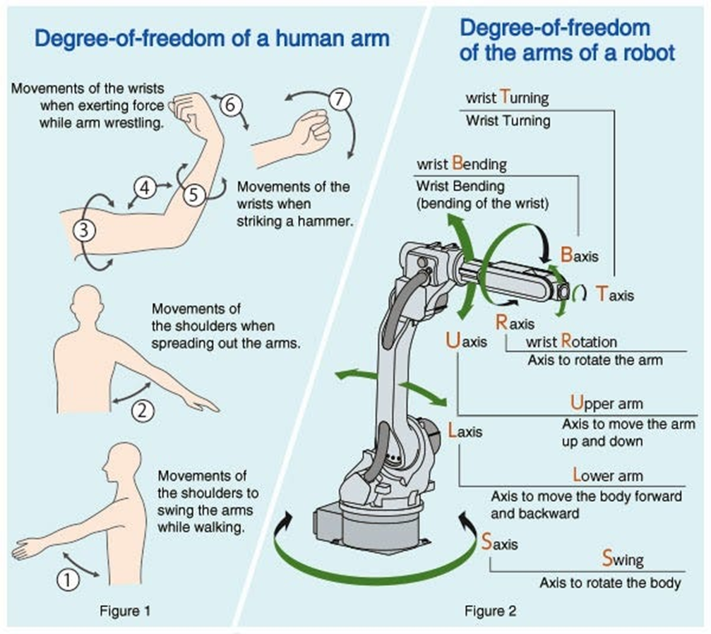
Robot Arm
A typical robot arm consists of:
Links – rigid parts of the robot
Joints – movable connections between links
End-effector – the tool attached to the robot (gripper, welder, etc.)
Example uses of robot arms include:
Industrial manufacturing
Medical surgery robots
Space robotics
Autonomous systems

Slide 6
Coordinate Frames in Robot Arms
Each link in a robot has its own coordinate frame.
A coordinate frame consists of:
X-axis
Y-axis
Z-axis
These frames help describe how one link moves relative to another.
To transform coordinates from one frame to another we use transformation matrices.

Slide 7
Denavit - Hartenberg (DH) Parameters
DH parameters provide a standard way to describe robot arms.
Each joint is described using four parameters:
θ (theta): Joint angle (rotation)
d: Link offset
a: Link length
α (alpha): Link twist
These parameters describe the transformation between two consecutive links.

Slide 8
Introduction to Kinematics
Kinematics is the study of motion geometry, positions, velocities, and accelerations, without considering forces.
It is a subfield of physics (part of classical mechanics) that describes the motion of points, objects, and systems without considering the forces that cause them to move
Core Concepts
Joint Space Task Space
(q₁, q₂, ..., qₘ) → (x, y, z, orientation)
(what we control) (what we care about)

Slide 9
Robot Kinematics
Kinematics studies motion without considering forces.
Robot kinematics focuses on how robot joints move to produce motion.
Two main problems:
Forward Kinematics - Find end-effector position when joint angles are known.
Inverse Kinematics - Find joint angles when the desired end-effector position is known.

Slide 10
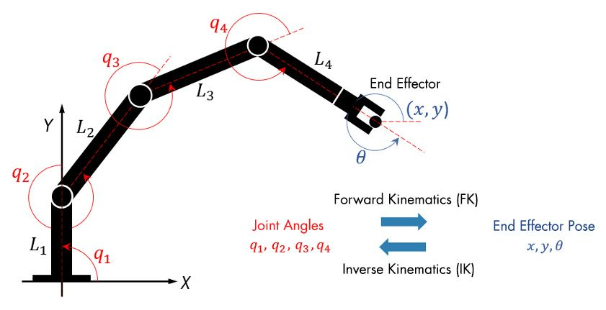
Introduction to Kinematics
Links: L1, L2, L3 and L4
Joints: q1, q2, q3, and q4
Configuring the joint positions of a robot using forward or inverse kinematics.

Slide 11
Forward Kinematics
Forward kinematics calculates the position of the end-effector when the joint angles are known.
Forward kinematics answers the question:
“Where is the robot hand if we know the joint angles?”
Input: Joint angles, robot link lengths
Output: Position and orientation of the robot hand.

Slide 12


Forward kinematics example
If a robot arm has two links,
Where,

Slide 13
Introduction to Kinematics - Key Elements
Links – Rigid bodies connected by joints
Joints – Revolute (rotation) or Prismatic (translation)
Degrees of Freedom (DOF) – Number of independent motions
Workspace – Volume reachable by the end-effector
Jacobian – Relates joint velocities to end-effector velocities
Simple analogy – Kinematics answers "How do the robot's parts move relative to each other?"

Slide 14
Joints
Revolute Joint (Rotation)
Prismatic Joint (Translation)
Motion. Provides pure rotation around a fixed axis.
Characteristics. Acts as a hinge or pin joint.
Degrees of Freedom. 1 (rotational).
Common Applications. Robot arm joints (elbow/shoulder), door hinges, car wheels.
Notation. Often denoted as 'R' in kinematic diagrams.
Motion. Enables linear, sliding, or extending movement along a straight path.
Characteristics. Acts as a slider or track, preventing rotation between the two parts.
Degrees of Freedom. 1 (translational).
Common Applications. Linear actuators, hydraulic/pneumatic cylinders, telescopic mechanisms, Cartesian (XYZ) robots.
Notation. Often denoted as 'P' in kinematic diagrams

Slide 15
Kinematics – Degree of Freedom
The degree of freedom of a physical system refers to those variables that are necessary to describe the movement of a body in space.
These can be translational or rotational movements.
For example, a classical hinge joint on a door has only one degree of freedom (rotation around an axis);
articulated robots often have the maximum possible six degrees of freedom (three translational, three rotational).

Slide 16
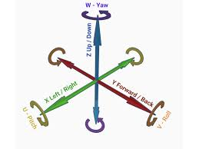
Six degrees of freedom
Six Degrees of Freedom (6DoF) in robotics refers to a robot's ability to move freely in 3D space,
Translation (Linear Motion): Movement along the X, Y, and Z axes (left/right, forward/backward, up/down).
Rotation (Angular Motion): Orientation changes through pitch (tilting), yaw (turning), and roll (twisting).

Slide 17
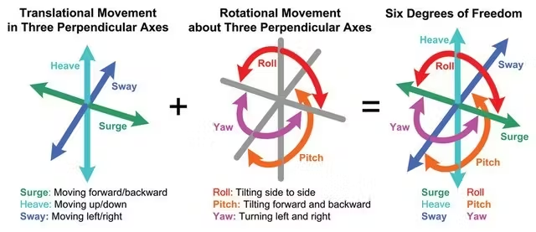
Six Degrees of Freedom (6DoF)

Slide 18
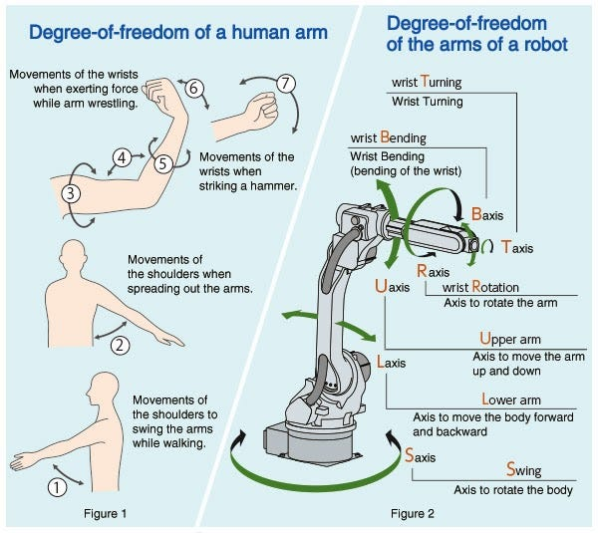
Six Degree of Freedom
Six Degrees of Freedom (6DoF) in robotics refers to a robot's ability to move freely in 3D space,
Translation (Linear Motion): Movement along the X, Y, and Z axes (left/right, forward/backward, up/down).
Rotation (Angular Motion): Orientation changes through pitch (tilting), yaw (turning), and roll (twisting).
https://thesmartwarehouse.org/courses/

Slide 19
Translational Degrees of Freedom (3DoF)
Translational degrees of freedom represent the ability to move in different directions. These include:
X-axis translation. Movement along the horizontal axis, often referred to as left-right or side-to-side motion
Y-axis translation. Movement along the vertical axis, often referred to as forward-backward or front-to-back motion
Z-axis translation. Movement along the depth axis, often referred to as up-down or vertical motion

Slide 20
Rotational degrees of freedom (3DoF)
Rotational degrees of freedom represent the ability to rotate or change orientation. These include:
Pitch (rotation about X-axis): Tilting forward or backward
Yaw (rotation about Y-axis): Turning left or right
Roll (rotation about Z-axis): Tilting sideways

Slide 21
Application of six degrees of freedom
Robotic arms have multiple joints that must move and rotate precisely in a three-dimensional space.
Robots that need to interact with the environment in various ways often require 6DoF to perform more complex tasks, such as placing objects or performing laparoscopic surgery with both accuracy and agility.
Robotic arms are typically used in manufacturing, research, and health care.
Six degrees of freedom in Humanoid robots with the ability to move in both translational and rotational degrees of freedom can closely mimic human movements, making it easier for these robots to perform tasks in dynamic environments like driving a vehicle or carrying objects.

Slide 22
What is a 6 degrees of freedom sensor?
A 6DoF sensor is an electronic device that measures all six degrees of freedom of an instrument as it navigates a space.
Highly specific 6DoF sensors measure these movements.
These devices have many uses for measuring movements with autonomous vehicles and medical devices, as well as applications in aerospace, industrial, and transportation sectors.

Slide 23
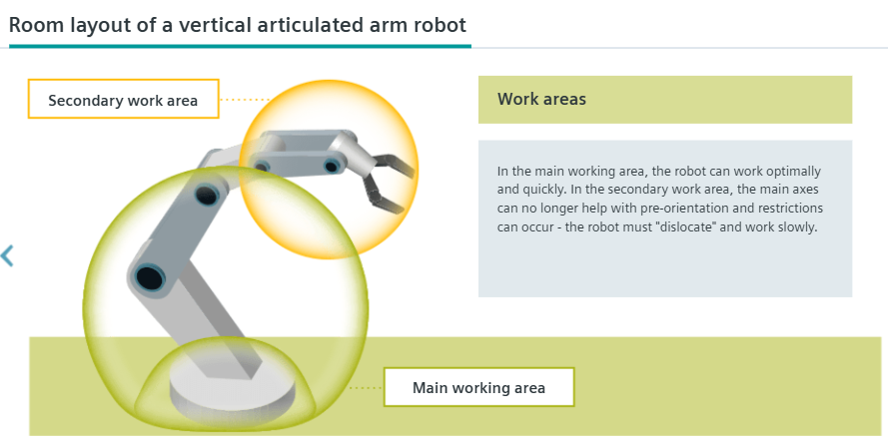
Workspace – Volume reachable by the end-effector

Slide 24
Introduction to Kinematics - Key Elements
Links – Rigid bodies connected by joints
Joints – Revolute (rotation) or Prismatic (translation)
Degrees of Freedom (DOF) – Number of independent motions
Workspace – Volume reachable by the end-effector
Jacobian – Relates joint velocities to end-effector velocities
Simple analogy – Kinematics answers "How do the robot's parts move relative to each other?"

Slide 25
The Jacobian Matrix – Bridging Joint Motion and Hand Motion
The Analogy - Steering a Car, think about driving a car...
Your Actions (Inputs) | Car's Movement (Output)
Turn steering wheel | Car turns left/right
Press gas pedal | Car speeds up
Press brake pedal | Car slows down
Key Insight: The same steering wheel turn gives different results at different speeds!
At low speed: Gentle turn
At high speed: Sharp turn
The "link" between input and output depends on current state.

Slide 26
The Analogy - What's the Lesson?
The relationship is not fixed, it changes with the situation.
Input (Your Actions) → [Current State] → Output (Car Motion)
(Steering wheel) (Car speed) (Turning radius)
The Jacobian is exactly this kind of "link" for a robot arm!
Robot Actions (Inputs) | Robot Hand Movement (Output)
Shoulder motor speed | Hand moves forward/back
Elbow motor speed | Hand moves up/down
Wrist motor speed | Hand rotates
The relationship depends on the robot's current pose!

Slide 27
Why Do We Need the Jacobian?
Use Case: In tasks like robotic painting, welding, or assembly, we don't just care where the robot ends up. We care about the velocity and path of the tool (end effector).
We want the paint sprayer to move at a constant speed for a smooth coat.
We want the welder to follow a straight line at a precise rate.
The Problem:
We control joint motor speeds (in rad/s).
We need to know the resulting end effector speed (in m/s and rad/s).
The Solution: The Jacobian matrix is the mathematical tool that converts joint velocities into end-effector velocities.

Slide 28
Applications
Industrial robots
Surgical robots
Space robotics
Autonomous manufacturing
Humanoid robots

Slide 29
The Jacobian Formula
Two important quantities
The Jacobian connects them
x˙=J(q)⋅q˙​
Read as: "End-effector velocity (ẋ) equals J times joint velocity (q˙)"
Symbol | Name | What it means
˙q | Joint Velocities | How fast each motor is turning
ẋ | End-Effector Velocities | How fast the hand is moving in the world

Slide 30
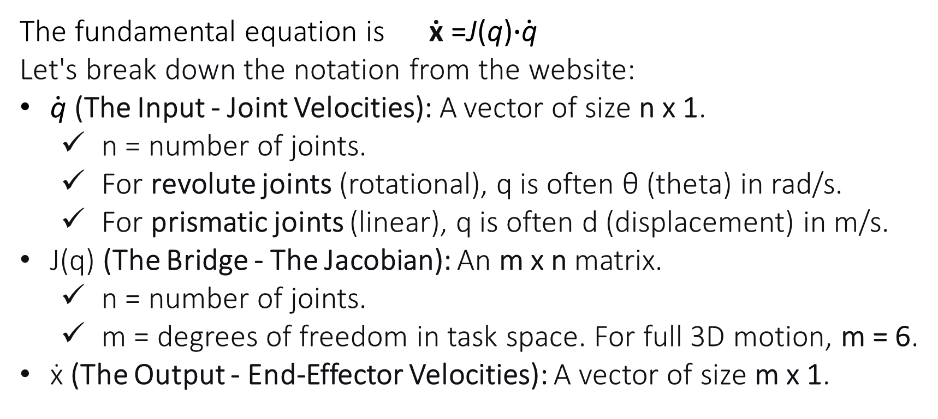
The Core Concept
The fundamental equation is ẋ =J(q)⋅$\dot{\text{q}}$​
Let's break down the notation from the website:
$\dot{\text{q}}$​ (The Input - Joint Velocities): A vector of size n x 1.
n = number of joints.
For revolute joints (rotational), q is often θ (theta) in rad/s.
For prismatic joints (linear), q is often d (displacement) in m/s.
J(q) (The Bridge - The Jacobian): An m x n matrix.
n = number of joints.
m = degrees of freedom in task space. For full 3D motion, m = 6.
ẋ (The Output - End-Effector Velocities): A vector of size m x 1.

Slide 31
The Output - What We Want to Know
Understanding the Velocity Vector ẋ
For a robot operating in 3D space (m=6), the end-effector velocity vector has six components
Linear Velocities. How fast is the end effector moving in the X, Y, and Z directions of the base frame?
[ ẋ ] (Linear X velocity)
[ ẏ ] (Linear Y velocity)
[ ż ] (Linear Z velocity)
Angular Velocities): How fast is it rotating around those same axes?
ẋ = [ ωx ] (Angular X velocity - roll)
[ ωy ] (Angular Y velocity - pitch)
[ ωz ] (Angular Z velocity - yaw)

Slide 32
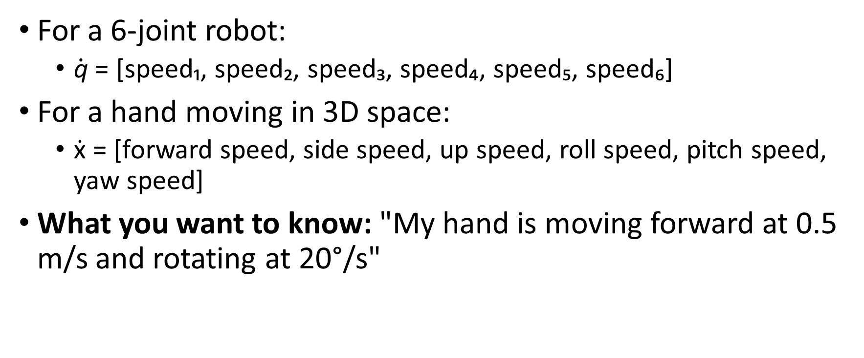
The Jacobian Formula
For a 6-joint robot:
$\dot{\text{q}}$ = [speed₁, speed₂, speed₃, speed₄, speed₅, speed₆]
For a hand moving in 3D space:
ẋ = [forward speed, side speed, up speed, roll speed, pitch speed, yaw speed]
What you want to know: "My hand is moving forward at 0.5 m/s and rotating at 20°/s"

Slide 33
The Jacobian Formula
J(q) (The Jacobian) - The Bridge
J(q) = [ numbers that change depending on the robot's pose ]
Crucial point. The Jacobian is NOT fixed. It changes for every single robot position!
Pose 1: Arm bent → Different J matrix
Pose 2: Arm straight → Different J matrix
Pose 3: Arm twisted → Different J matrix

Slide 34
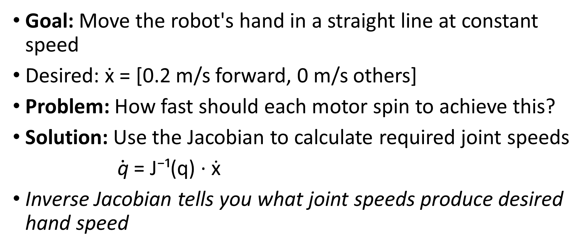
Velocity Control
Goal: Move the robot's hand in a straight line at constant speed
Desired: ẋ = [0.2 m/s forward, 0 m/s others]
Problem: How fast should each motor spin to achieve this?
Solution: Use the Jacobian to calculate required joint speeds
$\dot{\text{q}}$ = J⁻¹(q) · ẋ
Inverse Jacobian tells you what joint speeds produce desired hand speed

Slide 35
Jacobian – Joint and end-effector velocities
Jacobian – Relates joint velocities to end-effector velocities
The joint velocities. This is how fast each motor in the robot's shoulder, elbow, and wrist is turning.
The end-effector velocities. This is how fast the tool in the robot's hand is moving in the world (its speed forward/back, up/down, and how fast it's rotating).
The Jacobian matrix (J) answers the question: "If I move all the joints at these specific speeds, how fast will my robot's hand move in the world?"

Slide 36
The Jacobian
The Jacobian is the Translator
Think of the Jacobian as the essential translator between the world of what you control (motors spinning) and the world of what you want (a tool moving through space).
It enables precision and predictability in robot motion.
It is the foundation for advanced control, path planning, and understanding a robot's capabilities and limitations.

Slide 37
Practical example - 2-link planar robot arm
This will show exactly how the Jacobian matrix converts joint speeds into the speed of the robot's hand (end effector).
Key steps
Get DH parameters
Forward kinematics → position
Partial derivatives → Jacobian
Matrix multiply → hand velocity

Slide 38
Denavit - Hartenberg (DH) Parameters
Standard DH Convention for 2-Link Planar Arm:
Link i | θᵢ (joint angle) | dᵢ | aᵢ (link length) | αᵢ
1 | θ₁ (30°, 0.5236 rad) | 0 | L₁ | 0
2 | θ₂ (45°, 0.7854 rad) | 0 | L₂ | 0
Parameters for this example:
L₁ = 1.0 m (first link length)
L₂ = 1.0 m (second link length)
Both joints are revolute → θ₁ and θ₂ are variables
Arm is bent at 30° at shoulder, then another 45° at elbow
Joint angular velocities. θ₁ = 0.1 rad/s, θ₂ = 0.2 rad/s

Slide 39
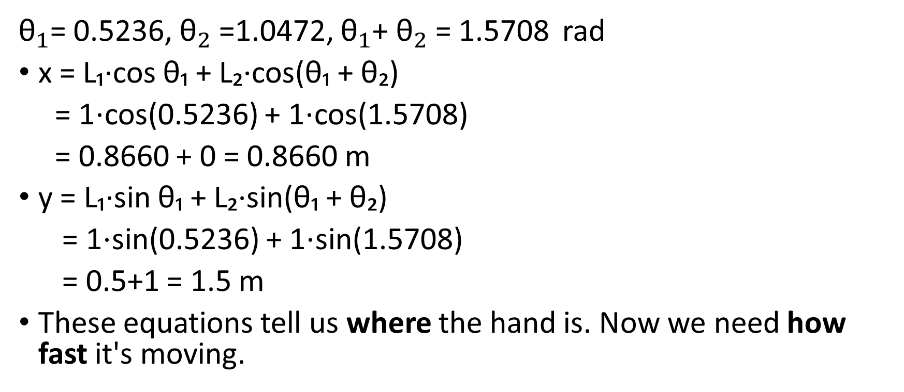
Forward Kinematics - Hand Position
${\text{θ}}_{1}$= 0.5236, ${\text{θ}}_{2}$=1.0472, ${\text{θ}}_{1}$+ ${\text{θ}}_{2}$= 1.5708 rad
x = L₁·cos θ₁ + L₂·cos(θ₁ + θ₂)
= 1⋅cos⁡(0.5236) + 1⋅cos⁡(1.5708)
= 0.8660 + 0 = 0.8660 m
y = L₁·sin θ₁ + L₂·sin(θ₁ + θ₂)
= 1⋅sin⁡(0.5236) + 1⋅sin⁡(1.5708)
= 0.5+1 = 1.5 m
These equations tell us where the hand is. Now we need how fast it's moving.

Slide 40

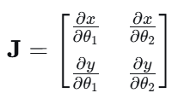
The Jacobian Matrix (Linear Velocity Only)
Relationship between joint velocities and hand velocity
For a 2-link planar arm, the Jacobian is a 2×2 matrix

Slide 41

Deriving the Jacobian Terms
Taking partial derivatives of forward kinematics
Term | Formula | Meaning
∂x/∂θ₁ | -L₁·sin θ₁ - L₂·sin(θ₁+θ₂) | How x changes with shoulder angle
∂x/∂θ₂ | -L₂·sin(θ₁+θ₂) | How x changes with elbow angle
∂y/∂θ₁ | L₁·cos θ₁ + L₂·cos(θ₁+θ₂) | How y changes with shoulder angle
∂y/∂θ₂ | L₂·cos(θ₁+θ₂) | How y changes with elbow angle
With L₁ = L₂ = 1.0 m

Slide 42


The Jacobian Matrix
Given: θ₁ = 30° (0.5236 rad), θ₂ = 45° (0.7854 rad) Therefore: θ₁ + θ₂ = 75° (1.3090 rad)
Sin θ₁ = sin 30° = 0.500, sin θ₁ + θ₂ = sin 75° = 0.9659
cos θ₁ = sin 30° = 0.8660, cos θ₁ + θ₂ = cos 75° = 0.2588

Slide 43


Set Up the Velocity Equation
Recall the relationship
Substituting the values

Slide 44
Hand Velocities - Matrix Multiplication
ẋ = (-1.4659 × 0.1) + (-0.9659 × 0.2), for ẋ (first row)
= -0.14659 + (-0.19318)
= -0.33977 m/s
Hand velocity moving left, negative result
ẏ = (1.1248 × 0.1) + (0.2588 × 0.2), for ẏ (second row)
= 0.11248 + 0.05176
= 0.16424 m/s
Hand velocity moving up

Slide 45
Key Takeaways
DH parameters provide the foundation for kinematic modeling
Forward kinematics gives position (x, y)
Jacobian matrix captures the velocity relationship
The Jacobian matrix connects joint velocities with end-effector velocity.
It shows how small joint movements affect the movement of the robot hand.

Slide 46
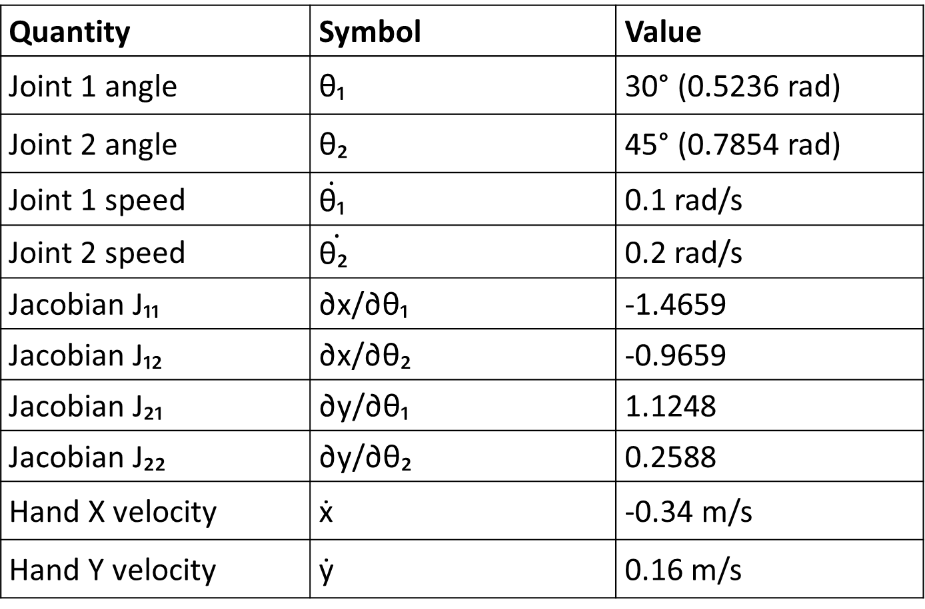
Summary of the Calculation
Quantity | Symbol | Value
Joint 1 angle | θ₁ | 30° (0.5236 rad)
Joint 2 angle | θ₂ | 45° (0.7854 rad)
Joint 1 speed | $$\dot{\text{θ}\text{₁}}$$ | 0.1 rad/s
Joint 2 speed | $$\dot{\text{θ}\text{₂} }$$ | 0.2 rad/s
Jacobian J₁₁ | ∂x/∂θ₁ | -1.4659
Jacobian J₁₂ | ∂x/∂θ₂ | -0.9659
Jacobian J₂₁ | ∂y/∂θ₁ | 1.1248
Jacobian J₂₂ | ∂y/∂θ₂ | 0.2588
Hand X velocity | ẋ | -0.34 m/s
Hand Y velocity | ẏ | 0.16 m/s

Slide 47
Practical example - 2-link planar robot arm
This will show exactly how the Jacobian matrix converts joint speeds into the speed of the robot's hand (end effector).
Key steps
Get DH parameters
Forward kinematics → position
Partial derivatives → Jacobian
Matrix multiply → hand velocity

Slide 48
Jacobian for a 6-DOF Robot
The Jacobian is a 6×6 matrix.
Top rows describe linear motion.
Bottom rows describe rotational motion.
It is used to solve inverse kinematics.

Slide 49
Inverse Kinematics
Inverse kinematics finds the joint angles needed to reach a desired target position.
Input: Desired end-effector position
Output: Joint angles.

Slide 50
Inverse Kinematics Using Jacobian
Steps:
1. Compute current end-effector position
2. Calculate error to target
3. Compute Jacobian matrix
4. Compute pseudo-inverse of Jacobian
5. Update joint angles
6. Repeat until robot reaches target.

Slide 51
Introduction to Kinematics - Fundamental Problems
Problem | Description | Difficulty
Forward Kinematics | Given joint angles, find end-effector pose | Always solvable, unique
Inverse Kinematics | Given desired pose, find joint angles | May have no/multiple solutions

Slide 52
Summary – Locomotion and Kinematics
Locomotion | Kinematics
Robot moving through environment | Robot arm positioning tool
"Travel" | "Reach"
Changes robot's location | Changes robot's configuration
Interaction with terrain | Geometry of motion
One key takeaway: Locomotion = moving the whole robot; Kinematics = moving the robot's parts

Slide 53
To do – Reading tasks.
For a 3D space, how do we calculate the value of z-coordinate in a forward kinematic?
Compute a Jacobian matrix for a 6-DOF revolute robot arm given link lengths and joint angles
Demonstrate with relevant example, how Jacobian can be used to determine the end-effector velocities (x, y and z) for 6-DOF revolute robot arm
Use Jacobian for reverse kinematics, where end effector position is known but angular velocities are not known

